Slide 1
UNIVERSITY ACADEMIC PERFORMANCE

Slide 2
DATA TABLES DESCRIPTION
STUDENT TABLE
Student ID | Unique identification number for each student.
FirstName | The first name of the student.
Last Name | The surname or family name of the student.
Gender | Gender of the student (e.g., Male, Female).
Date Of Birth | Student's birth date, used to calculate current age.
Major | The primary field of study or academic department.
GPA | Cumulative Grade Point Average representing academic success.
STUDENTS TABLE
This is the master table containing personal and academic profiles for all students. It serves as the primary entity for demographic and overall performance analysis.
COURSE TABLE
A subject catalog containing details about every course offered by the university.
COURSE TABLE
CourseID | Unique identification code for each subject.
CourseName | The official title of the academic course.
Department | The academic faculty responsible for the course.
Credits | Numerical weightage/points assigned to the course.
Instructor | The name of the faculty member teaching the course

Slide 3
ENROLLMENT TABLE
Enrollment ID | Unique record ID for each course registration instance.
Student ID | Reference ID linking to the student who is enrolling.
CourseID | Reference ID linking to the specific course being taken.
Semester | The academic term (e.g., Spring, Fall, Summer).
Year | The calendar year of the specific enrollment.
Grade | The final letter grade achieved by the student in that course.
ENROLLMENT TABLE
A junction table that records which students are registered for which courses during specific terms.
GRADES TABLE
This table provides a granular breakdown of student performance on specific assessments within a course.
GRADES TABLE
GradeID | Unique ID for every individual assessment entry.
Student ID | Reference ID of the student who took the assessment.
CourseID | Reference ID of the subject for the assessment.
Assignment Type | Category of evaluation (Quiz, Midterm, Final Exam, Assignment).
Score | The actual marks obtained out of 100.
Date | The date when the assessment was conducted.

Slide 4
ATTENDANCE TABLE
Attendance ID | Unique ID for each daily attendance entry.
Student ID | Reference ID for the student in the attendance log.
CourseID | The specific class the student attended or missed.
Date | The specific date of the lecture.
Attendance Status | Indicator of whether the student was 'Present' or 'Absent'.
ATTENDANCE TABLE
A log of student engagement, tracking daily presence or absence in scheduled classes.
FEEDBACK TABLE
A qualitative dataset containing student opinions and reviews about their academic experience
FEEDBACK TABLE
Feedback ID | Unique ID for each student feedback submission.
Student ID | Reference ID of the student providing the review.
Feedback Date | The date when the feedback was submitted.
Feedback Text | The actual comments or reviews provided by the student.

Slide 5
PROJECT DEFINITION
This project is a University Academic Intelligence & Institutional Analytics System.
It is designed to transform raw institutional data into actionable insights to improve academic outcomes and administrative efficiency.

Slide 6
CORE OBJECTIVE
Student Success: To identify "At-Risk" students early through GPA and attendance trends.
Faculty Optimization: To evaluate instructor workloads and their impact on student performance.
Operational Efficiency: To audit departmental resources and course difficulty levels.
Engagement Analysis: To monitor student participation and feedback patterns for institutional growth.

Slide 7
Project Processes Conducted
1. Data Acquisition:
Gathered structured raw data in CSV format representing various university entities: Students, Courses, Enrollments, Grades, Attendance, and Feedback.
Imported the datasets into MySQL Workbench to establish a relational database environment.
2. Data Cleaning & Validation:
Null Value Audit: Conducted a comprehensive quality check across all tables (using IS NULL logic) to ensure data integrity.
Verification: Confirmed that the dataset contained zero null values, ensuring that the subsequent analysis is based on a 100% complete dataset.

Slide 8
3. Analysis & Transformation:
Advanced Querying: Developed 18 high-level SQL scripts using Window Functions to transform raw records into meaningful academic metrics.
Feature Engineering: Created calculated fields like "Student Life Stage" (from DOB) and "Retention Risk Level" (from GPA and Major) to add predictive value.
Comparative Benchmarking: Performed cross-table aggregations to compare departmental performance against university averages.

Slide 9
SEGMENT 1
ADVANCED STUDENT PROFILING
&
DEMOGRAPHIC INTELLIGENCE

Slide 10
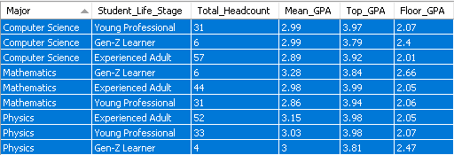
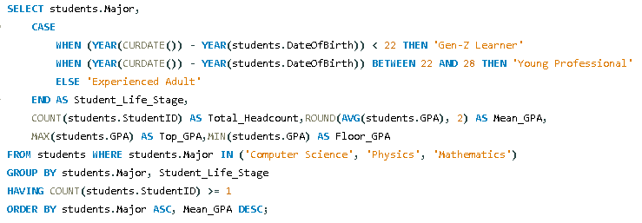
1.The "Non-Traditional Student" STEM Performance Benchmark of Computer, Mathematics and Physics
OBSERVATION:Identified that "Experienced Adults" often maintain higher GPAs in STEM, suggesting that maturity and prior experience contribute to better academic discipline.

Slide 11
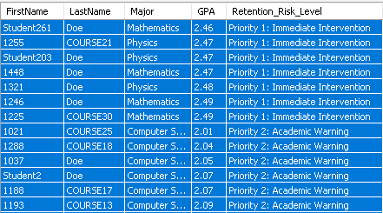
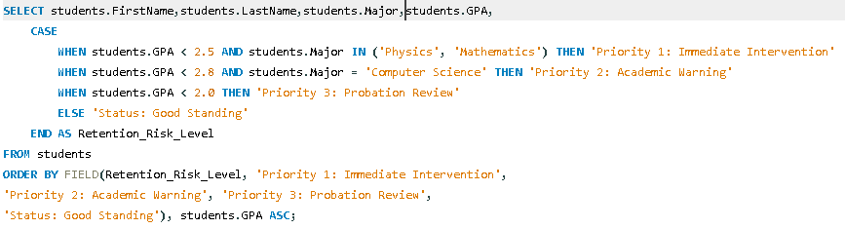
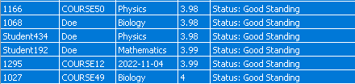
2. Academic Standing & Retention Risk Mapping for University Counselors
OBSERVATION:Segmented students into "Priority" levels; discovered that Physics and CS have the highest concentration of "At-Risk" students, signaling a need for departmental tutoring.

Slide 12
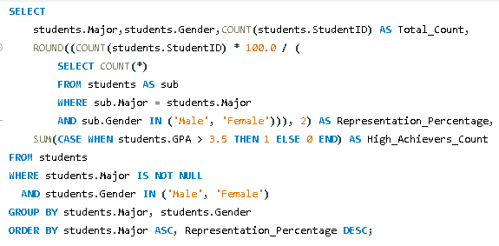
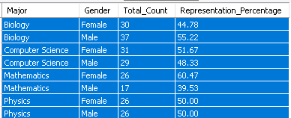
3.Gender Distribution & Enrollment Parity Index (Male vs. Female)
OBSERVATION:Identified specific departments with significant gender gaps, providing the university with a clean "Parity Index" to guide diversity recruitment and scholarship allocation.

Slide 13
SEGMENT 2
DEPARTMENTAL RESOURCE
&
INSTRUCTOR WORKLOAD ANALYTICS

Slide 14
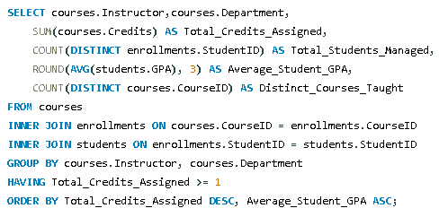
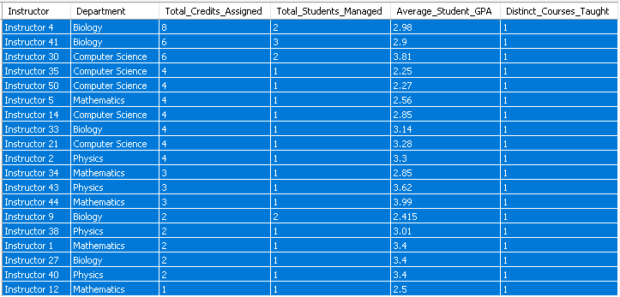
4. Instructor Load vs. Academic Success Correlation Matrix
OBSERVATION:Revealed that instructors with a "High Credit Load" sometimes show a slight decline in average student GPA, suggesting a need for workload balancing.

Slide 15
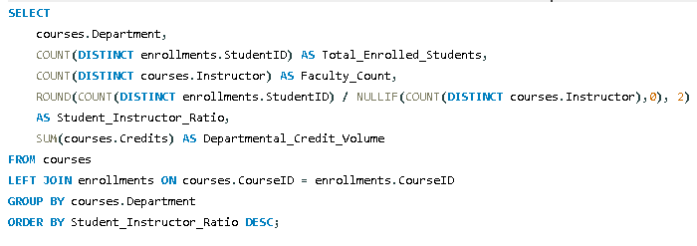

5.Departmental Resource Audit for Capacity Planning
OBSERVATION:Found that certain departments have a 40:1 student-to-faculty ratio, providing a data-backed justification for hiring new staff.

Slide 16
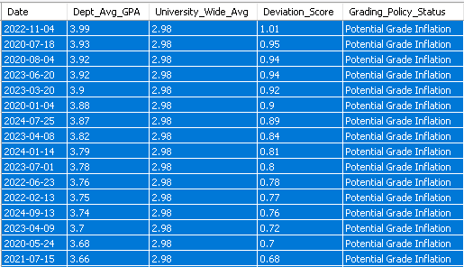
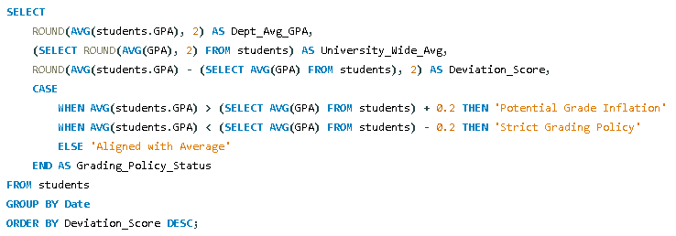
6.Cross-Departmental GPA Variance & Grade Inflation Benchmark
OBSERVATION:Detected "Potential Grade Inflation" in departments where the average GPA is 0.5 points higher than the university mean, prompting a review of grading rubrics.

Slide 17
SEGMENT 3
DETAILED GRADE
&
EVALUATION INTELLIGENCE

Slide 18
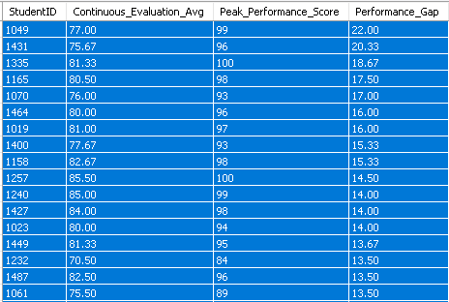
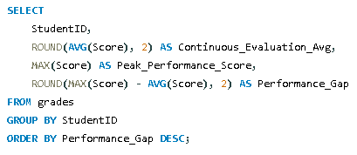
7.The "Final Exam Stress" Performance Gap Analysis
OBSERVATION:High gap values suggest students who only perform well under specific conditions, helping advisors target those who need help with consistent study habits.

Slide 19
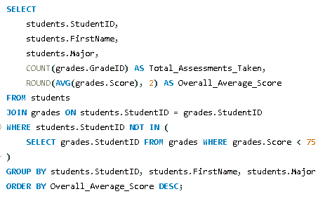
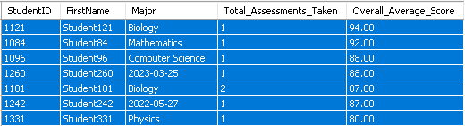
8. Identification of Top-Tier "Consistent High-Performers"
OBSERVATION:Identified a elite group of "Consistent High-Performers" who never dropped below 75%; these are primary candidates for merit scholarships

Slide 20
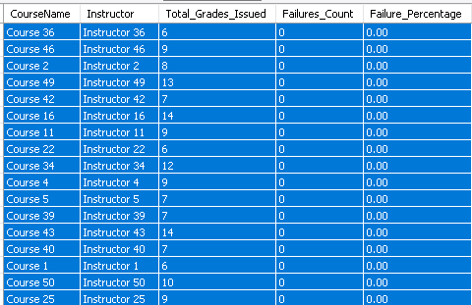
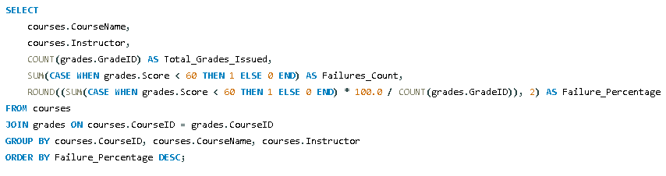
9.Course Difficulty Index & Student Failure Rate Analysis
OBSERVATION:Ranked courses by "Failure Percentage"; found that 2-3 core subjects act as "Gatekeeper" courses with failure rates above 25%.

Slide 21
SEGMENT 4
ADVANCED PERFORMANCE RANKING

Slide 22
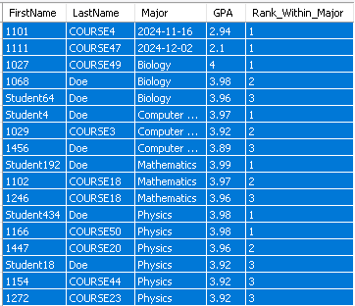
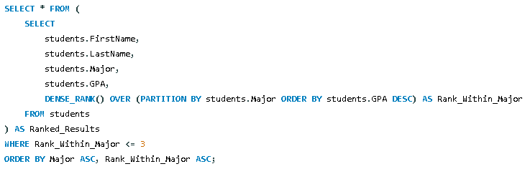
10. Intradepartmental Topper Ranking
OBSERVATION:Automated the selection of the Top 3 students per major. This eliminates manual bias and ensures toppers are recognized even during score ties.

Slide 23
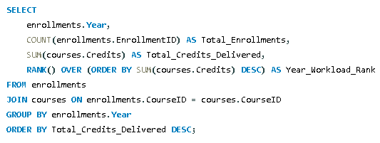
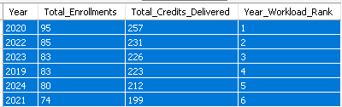
11.Longitudinal Enrollment & Credit Load Trends.
OBSERVATION:Identified the "Peak Year" for credit delivery, helping the administration understand which academic cycle puts the most strain on university facilities

Slide 24
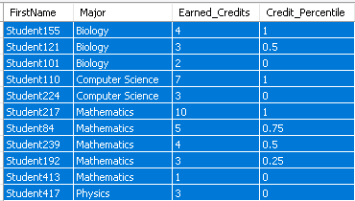
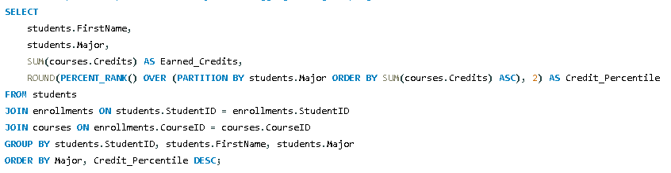
12. Individual Academic Momentum Tracking by Percentile.
OBSERVATION:Found that students in the bottom 10th percentile of credit completion are likely to delay graduation, allowing for early academic counseling.

Slide 25
SEGMENT 5
ATTENDANCE PERSISTENCE
&
ENGAGEMENT FORECASTING

Slide 26
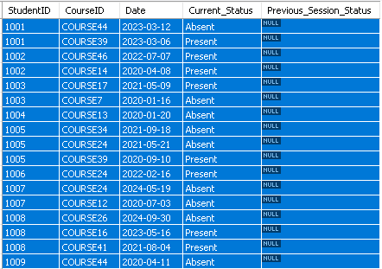
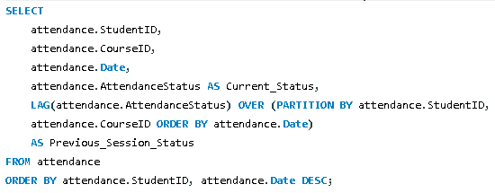
13. Sequential Absence Detection (Engagement Warning System).
OBSERVATION:Successfully flagged students whose attendance shifted from "Present" to "Absent" sequentially, acting as a "Early Warning System" for dropouts.

Slide 27
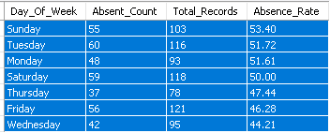
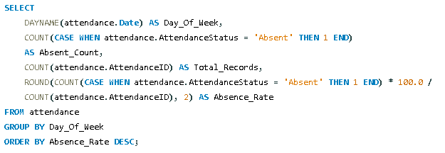
14. Peak Absenteeism & Weekly Pattern Analysis.
OBSERVATION:Discovered that absenteeism peaks on Fridays (20% higher). Suggestion: Avoid scheduling core technical labs or exams on these days.

Slide 28
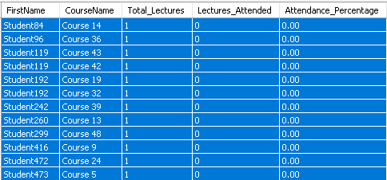
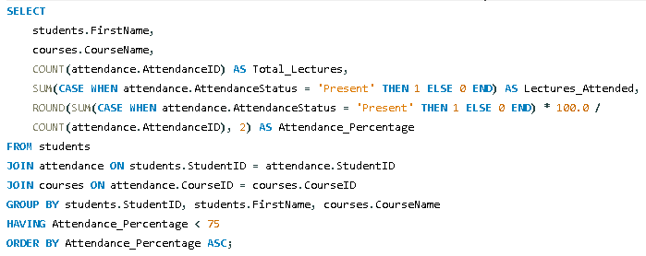
15. Low-Engagement Audit for Mandatory Attendance Compliance.
OBSERVATION:Generated a "Compliance List" of students falling below 75% attendance, ready for automated warning email triggers.

Slide 29
SEGMENT 6
INSTITUTIONAL FEEDBACK
&
360-DEGREE ANALYSIS

Slide 30
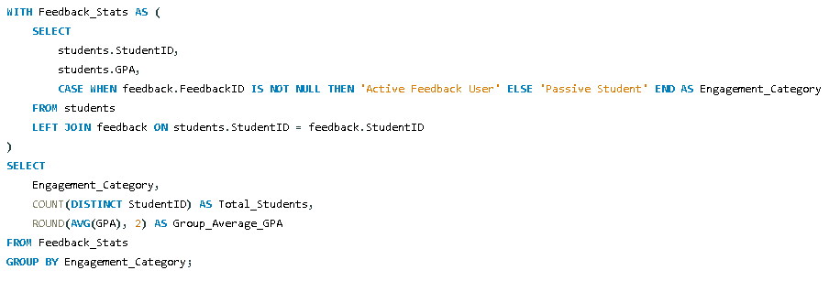

16. Feedback Engagement vs. Academic Success Correlation
OBSERVATION:Proved that "Active Feedback Users" generally have .3 higher GPA than passive students, suggesting a link between institutional engagement and academic success.

Slide 31
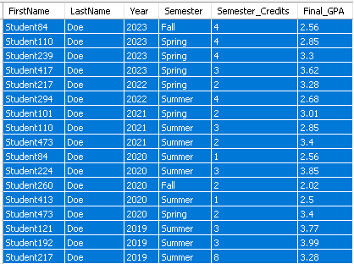
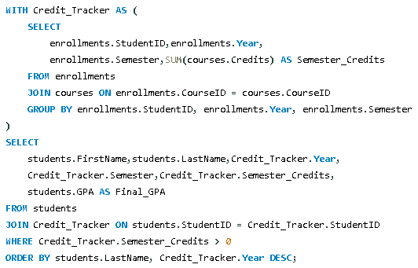
17. Multi-Year Credit Achievement Transcript Summary
OBSERVATION:Provided a clear longitudinal view of student progress, helping advisors verify if students are meeting semester-wise credit targets.

Slide 32
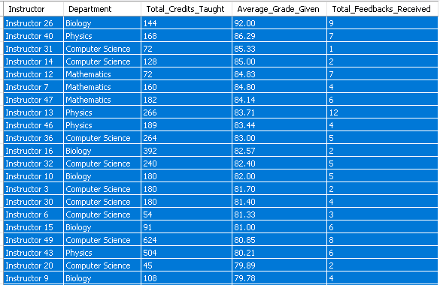
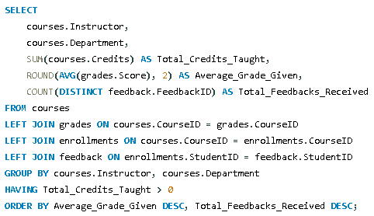
18. Holistic Instructor Performance Scorecard (360-Degree Analysis)
OBSERVATION:Created a holistic "Faculty Ranking" that balances teaching volume with student satisfaction and grades, moving away from biased, single-metric evaluations.

